Slide 1
Explorations in Data Analyses for Metagenomic Advances in Microbial Ecology
10 August 2017 – Ashley Shade
shadeash@msu.edu
Kellogg Biological Station
Michigan State University

Slide 2
Diversity Outline
The confusion about diversity
Within-Sample (alpha) diversity
Subsampling
Comparative (beta) diversity
Directing your data exploration to your question
Categories of metadata for comparative diversity analysis: categories/clusters v. gradients
Resemblances
Ordination
Hypothesis testing

Slide 3
Diversity in all of its glory
“Diversity” is a vague word. In ecology, it has there are many types of diversity (e.g., alpha, beta, gamma), and there are many components to that contribute to those types.
Alpha diversity refers to the diversity inherently descriptive of one sample.

Slide 4
Whittaker introduces alpha, beta, gamma diversity (1972)

Slide 5
The confusion continues… for decades
Ecology Letters 2011
Oecologia 2010

Slide 6
We don’t measure diversity well
Diversity does not have an absolute value upon which multiple scales or methods of measuring will agree (think about temperatures: it doesn’t matter if you measure in Celsius or Farenhiet, you still measure the “same” value of temperature
Diversity depends on OTU definitions, method of measurements, method of data processing, and choice of diversity index/metric.
It is very difficult to compare alpha diversity across studies or investigators
Thus, great care is needed for interpreting such comparisons.

Slide 7
Within-sample (aka alpha) diversity
Within-sample diversity includes:
Richness (number of taxa)
Evenness (distribution of the abundances of taxa)
Phylogenetic diversity (breadth of phylogenetic representation)
*Composition (who’s there – identity of the taxa)
Combinations of the above components are used to calculate other diversities: Shannon diversity, Simpson, etc.

Slide 8
Within-sample diversity
Information about the community that we can glean from metagenomic sequencing
A certain number of OTUs- richness
Each OTU is present in a certain abundance- collectively, evenness
Each OTU has a taxonomic assignment- composition
Phylogenetic breadth - how related are the lineages represented in the community?
C₆H₁₂O₆
CH₄
CO₂
CO₂
C₂H₃O₂⁻
Acyl-HSL
O₂
HPO₄²⁻
NH₄⁺
H₂
NO₃⁻
N₂
MeS
SO₄²⁻
HS⁻
Me²⁺

Slide 9
Richness
Richness: How many OTUs?
OTU
Richness = 11 OTUs

Slide 10
Evenness
Evenness: What is the distribution of abundances in the community?
OTU
Count:
No. seq, no. individuals (e.g., FISH), biomass, etc.
6
1
4
8
1
5
3
13
5
1
2

Slide 11
Evenness
Evenness: What is the distribution of abundances in the community?
OTU
Count:
13
Even
Uneven
8
6
5
5
4
Abundance
Abundance
3
2
1
1
Rank (highest to lowest)
Rank (highest to lowest)
1

Slide 12
Membership and Composition
Composition: Who is there?
OTU
Count:
13 Alpha-proteobacteria
8 Firmicutes
6 Beta-proteobacteria
5 Bacteroidetes
5 Actinobacteria
4 TM7
3 Alpha-proteobacteria
2 Gamma-protobacteria
1 Bacteroidetes
1 Bacteroidetes
1 Verrucomicrobia

Slide 13
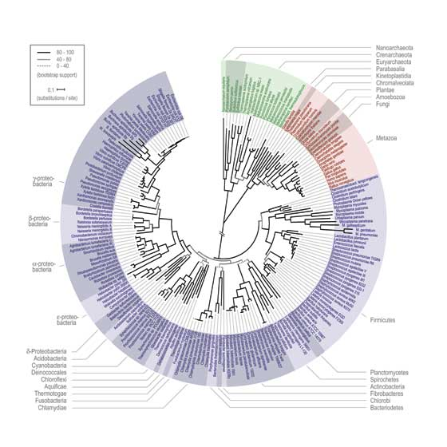
The advantages of phylogeny
Common metric =
Faith’s phylogenetic diversity
Phylogenetic diversity: What is the breadth of phylogenetic representation?
OTU
Count:
13 Alpha-proteobacteria
8 Firmicutes
6 Beta-proteobacteria
5 Bacteroidetes
5 Actinobacteria
4 TM7
3 Alpha-proteobacteria
2 Gamma-protobacteria
1 Bacteroidetes
1 Bacteroidetes
1 Verrucomicrobia

Slide 14
A final word about within-sample diversity
Higher diversity isn’t necessarily better or healthier. Diversity is the outcome of ecological processes, not an ecological process in itself.

Slide 15
Subsampling: Get “even”
Because of sequencing artifacts and experimental design, there can be quite a range of quality sequences returned for each sample.
Sub-sampling of sequences to achieve an even number across all samples within a dataset allows for comparing diversity across samples.
This is very important for being able to compare diversity across samples.
Analogy: You are a tree ecologist. Would it be reasonable to directly compare the forest diversity (assessed by counting different types of trees) in a 1x1 m plot to a 1000 x 1000 km plot? The second plot has 1000x the coverage as the first and thus the comparison is unsound.
This is a question of the observational effort. We can only compare communities observed at an equal observational effort.
Choose a sequencing depth that maximizes the number of samples that can be included at the most informative sequencing depth.
If you have obvious outliers in sequencing depth (e.g., the median depth is 70K and you have one sample with 1000 sequences), get rid of it and save yourself heartache.

Slide 16
Rarefaction for estimating diversity given coverage
I call this “exploratory” rarefaction
It lets us understand how well we’ve observed our community
Calculate a diversity of choice (e.g., richness)
The question asked: Given an increase in sequencing (observation/coverage) effort, how likely are we to observe a new taxon?
Exploratory rarefaction happens to understand your coverage BEFORE subsampling to an even sequencing effort

Slide 17
Diversity Part 1 Review
Within-sample diversity describes a single community/ sample, and includes metrics of richness, evenness, phylogenetic diversity, and other summative metrics of diversity.
Because sequencing success can be highly variable, rarefaction is used to ensure an even-depth of sequences across communities that will be compared.
Alternative normalization methods cannot substitute for low quality data or a poor sequencing run!

Slide 18
Outline: Comparative (beta) diversity
What questions can you ask about your microbial communities?
Comparative diversity
Calculating community resemblance
Visualizations: Ordinations, heatmaps, dendrograms
Gradients versus categories (clusters)
Statistical analysis of clusters: Hypothesis testing for differences in categorical groups
Statistical analysis of gradients: Linking environmental variables to changes in community structure

Slide 19
Questions about microbial communities
Summary information for each community: Within-sample (alpha) diversity
Differences between communities: Comparative (beta) diversity

Slide 20
Ask yourself: What is the purpose of the analysis?
Exploration/Discovery: hypothesis generating, perfect for observational studies, includes visualizations like ordinations and clustering
Hypothesis testing: address a specific question (e.g., are there differences among treatment groups?), and usually permutation-based (non-parametric) p-value

Slide 21
What questions do you want to ask about your microbial communities?

Slide 22
Comparative diversity
Space / Time
Categories (e.g., fire-affected, recovered)
Gradients/empirical measurements (e.g., pH, temperature, chemistry)
Look forward to Stuart’s R lecture on category/gradient analyses!

Slide 23
Analysis of comparative diversity is informed by:
Associated environmental/quantitative variables*
Examples: temperature, red blood cell counts, glucose levels, dissolved oxygen, temperature, acidity, time, % mortality, etc.
Associated categorical/descriptive/qualitative variables*
Examples: treatment groups, male/female, control/treatment, age groups, before/after
* Environmental and categorical variables often are linked to samples in a single “mapping file”

Slide 24
Comparative diversity requires a measure of pair-wise community resemblance
Resemblance = distance, similarity, dissimilarity
Important decisions in choosing a resemblance metric:
Weighted v. Unweighted
Phylogenetic v. Taxonomic
All pairs of resemblances are included in a sample by sample resemblance (distance/similarity) matrix
Simplifies the data and the analysis
Choice of resemblance metric will influence the outcome of community analysis

Slide 25
Calculating resemblance: Bray-Curtis Example
d_{jk} = (sum abs(x_{ij}-x_{ik})/(sum (x_{ij}+x_{ik}))
Where d_{jk} is the Bray-Curtis index between samples j and k
and x is the (relative) abundance of taxa I
See Legendre and Legendre book: Numerical Ecology. Chapter 7: “Ecological resemblance” for a comprehensive discussion of All the Resemblances Ever.

Slide 26
Making a Resemblance Matrix
1. OTU table (usually relativized)
 | Soil 1 | Soil 2 | Soil 3
OTU 1 | 0 | 0.966 | 0.179
OTU 3 | 0.047 | 0.002 | 0.039
OTU 3 | 0.953 | 0.032 | 0.782
2. Chose appropriate resemblance (e.g., Bray Curtis, UniFrac)
 | Soil 1 | Soil 2 | Soil 3
Soil 1 | 0
Soil 2 | 0.966 | 0
Soil 3 | 0.179 | 0.787 | 0
3. Create a square (observation x observation) resemblance matrix from pair-wise comparisons.
Notes:
The purpose of a resemblence matrix is to reduce complexity in the dataset so that it can be used for hypothesis testing or exploration analyses

Slide 27
Examples of Resemblance metrics
Weighted metrics
Unweighted metrics
Phylogenetic metrics
Taxonomic metrics
Metric name Accounts for | Sørensen | Bray-Curtis | Weighted UniFrac | Unweighted UniFrac
Composition | X | X | X | X
OTU abundances? |  | X | X
Phylogenetic diversity? |  |  | X | X

Slide 28
We can compare different distance/similarity measures to deduce the most important components of community structure for the overarching patterns observed (This does not mean we “pick” the best ordination for our hypothesis - confirmation bias)

Slide 29
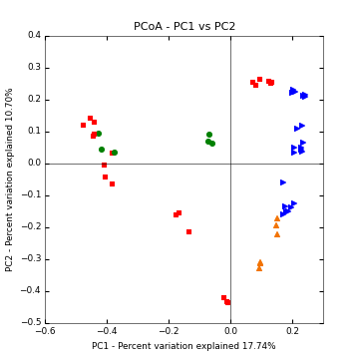
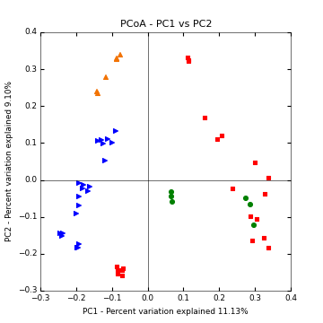
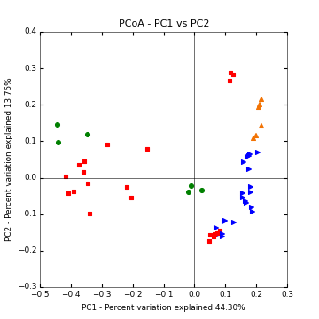
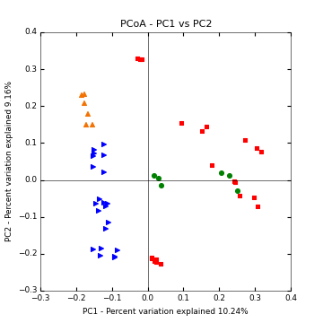
Example: Centralia coal mine fire-affected soils
Weighted
Unweighted
Bray-Curtis
Sorenson
Taxonomic
Weighted UniFrac
Unweighted UniFrac
Phylogenetic

Slide 30
Useful community visualization tools
Ordination : Calculated from community resemblance; relationships are represented by distances between symbols
Heatmap : Calculated from count/abundance data; The abundance of each taxon relative to the others depicted by color
Dendrogram: Calculated from community resemblance; similar communities fall into same cluster.

Slide 31
Visualizing communities: ordination
Legend
Treatment 1
Control
Axis 2: 6% variance explained
Axis 1: 50% variance explained
2 or 3 dimensional representation of the data
Each symbol is one community (compared by the chosen resemblance metric)
The distance between symbols represents the extent of differences between communities
First axis often explains most variance in the data, variation explained should be provided.

Slide 32
Types of ordinations
Non-metric multidimensional scaling (NMDS)
Makes fewest assumptions, rank based, non-metric so cannot subsequently correlate to environmental measures
Principal coordinates analysis (PCoA)
Assumes linear response of taxa, can use any resemblance
Special case Principal Components Analysis (PCA): based on Euclidean distance and not appropriate for communities (for environmental variables, PCA is okay)
Constrained version: Redundancy Analysis (RDA): variation in communities are constrained to be explained only by the measured variables. This is only okay if the ordination of the PCoA matches the RDA, which means that the important/most explanatory environmental variables were measured. Constrained analyses can be used for variance partitioning.
Correspondence analysis (CA)
Assumes unimodal response of taxa, uses chi-squared distance
Constrained version: Constrained (Canonical) Correspondence Analysis (CCA)
Detrended correspondence analysis- if there is a large “horseshoe” or “arch” affect because too much variability is being squished onto too few dimensions; not often advisable.
Avoid: Principle components analysis (PCA) for communities, Redundancy analysis (RDA) in situations that do not have a strong gradient (e.g., time) and detrended analyses unless you really know what you are doing.

Slide 33
How do we look at ordinations?
Think about: CENTROID (mean) or DISPERSION (spread, variability)
A. Different centroid, same spread
B. Different centroid, different spread
C. Same centroid, different spread

Slide 34
Visualizing communities: dendrograms
A different way of visualizing the same data
=
Legend
0%
Treatment 1
Control
Resemblance
50%
100%
Notes:
Note: cluster is not the same as phylogenetic analysis.

Slide 35
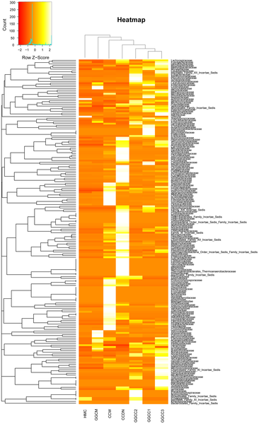

Visualizing communities: heatmaps
Figure 6. Bacterial distribution among the seven samples.
Wu S, Wang G, Angert ER, Wang W, et al. (2012) Composition, Diversity, and Origin of the Bacterial Community in Grass Carp Intestine. PLoS ONE 7(2): e30440. doi:10.1371/journal.pone.0030440
http://www.plosone.org/article/info:doi/10.1371/journal.pone.0030440

Slide 36
Discovering patterns: Clusters & Gradients
Clusters = Are groups different? (e.g., Treatment v. Control)
Also called: factors, qualitative variables
Gradients = Do communities change with known environmental changes? (e.g., over time?)
Also called: continuous, quantitative, vector variables

Slide 37
How do we interpret ordinations?
Think about: CENTROID (mean) or DISPERSION (spread, variability)
A. Different centroid, same spread
B. Different centroid, different spread
C. Same centroid, different spread

Slide 38
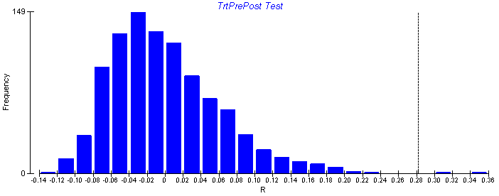
Non-parametric hypothesis tests
Non-parametric tests are used to test hypotheses of multivariate data when the underlying distribution of the data is unknown.
Non-parametric tests randomly re-sample the dataset to create a re-shuffled distribution, calculate a test statistic for each random distribution, and then ask the probably of finding the actual statistic given the random re-sampling distribution of the data.
It is important to use these tests for microbial beta diversity, as the assumptions of underlying normal distributions of most parametric tests (e.g., ANOVA) are violated.

Slide 39
Clusters: Testing for differences in a priori groups
Permutation-based analyses to test hypotheses about group differences in CENTROID (mean) or DISPERSION (spread, variability)
A. Different centroid, same spread
Test name | Centroid (mean) | Spread (variability)
PERMANOVA | X | X
MRPP | X | X
ANOSIM | X | X
PERMDISP |  | X
B. Different centroid, different spread
C. Same centroid, different spread

Slide 40
Hypothesis tests
Analysis of similarity (ANOSIM): rank based, least sensitive, makes fewest assumptions, permuted p-value
Multi-Response Permutation Procedure (MRPP): metric, permuted p-value
Permuted analysis of variance (PERMANOVA): assumes pseudo-F distribution, can accommodate a range of ANOVA-type experimental designs
Permutated analysis of dispersion (PERMDISP): p-values from permutation of residuals – tests specifically for differences in dispersion around centroid

Slide 41
A paper where every hypothesis test is used with every resemblance. Ever.
(just kidding)
(kind of)
The methods are useful.
Shade et al. 2013 AEM

Slide 42
Gradients: Linking environmental and community data
1. Mantel Test
2. Vector fitting to ordination axis score
Community Resemblance
 | Caterpillar 1 | Caterpillar 2 | Caterpillar 3
Caterpillar 1 | 0
Caterpillar 2 | 0.966 | 0
Caterpillar 3 | 0.179 | 0.787 | 0
Pearson’s correlation
Permuted p value
Axis 2
Time
Time / environ. distance
Temperature
 | Caterpillar 1 | Caterpillar 2 | Caterpillar 3
Caterpillar 1 | 0
Caterpillar 2 | 1 | 0
Caterpillar 3 | 10 | 3 | 0
Axis 1

Slide 43
Exercise: Make your own ordination
 | A | B | C | D | E
OTU1 | 0 | 2 | 3 | 4 | 8
OTU2 | 5 | 6 | 7 | 0 | 0
OTU3 | 20 | 10 | 7 | 0 | 0
OTU4 | 5 | 12 | 5 | 12 | 0
OTU5 | 0 | 0 | 4 | 7 | 11
OTU6 | 0 | 0 | 4 | 7 | 11

Slide 44
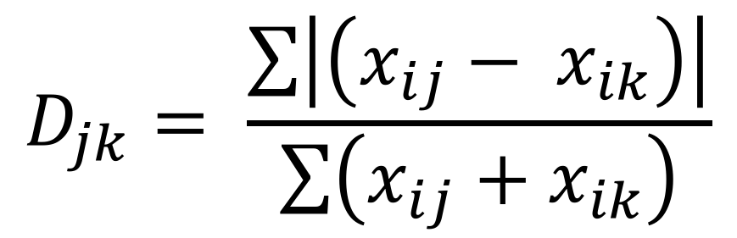
How do we do this?
Step 1: make a Bray-Curtis resemblance matrix (square)
$$D_{jk}= \frac{\sum{\left|\left(x_{ij}− x_{ik}\right)\right|}}{\sum{\left(x_{ij}+x_{ik}\right)}}$$

Slide 45
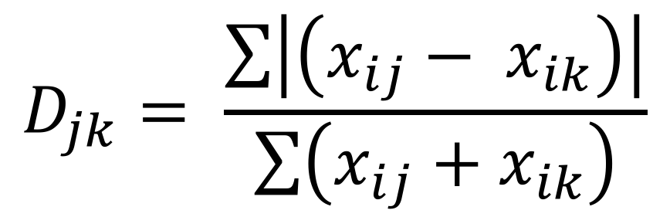
Make your own ordination
 | A | B | C | D | E
OTU1 | 0 | 2 | 3 | 4 | 8
OTU2 | 5 | 6 | 7 | 0 | 0
OTU3 | 20 | 10 | 7 | 0 | 0
OTU4 | 5 | 12 | 5 | 12 | 0
OTU5 | 0 | 0 | 4 | 7 | 11
OTU6 | 0 | 0 | 4 | 7 | 11
$$D_{jk}= \frac{\sum{\left|\left(x_{ij}− x_{ik}\right)\right|}}{\sum{\left(x_{ij}+x_{ik}\right)}}$$

Slide 46
Step 2: Arrange the first axis According to Bray and Curtis, 1957
“This technique depends upon the selection of a pair of reference stands for the determination of stand positions on any one axis. […] those stands which are furthest apart will be more accurate for judging interstand distance than those which are in close proximity. […] The choice of reference stands should be, therefore, of those stands which are furthest apart and as a consequence, have the greatest sensitivity to over-all compositional change.”
Thus, for the first, axis:
Select reference points (communities).
Arrange all other points in a straight line between the references, representing their differences from the references.

Slide 47
Step 3: Arrange the second axis More from Bray and Curtis:
“Two new reference stands are selected which are in close proximity on the x axis, but which are nevertheless separated by a great interstand distance”
Thus, for the second axis:
Chose two communities on the first axis line that are in close proximity and yet have the largest distance between them by the resemblance calculation. Allow these two to serve as “references” for the range of axis 2.
Arrange all other samples at their original Axis 1 position, but in reference to their resemblance to the new references on Axis 2.

Slide 48
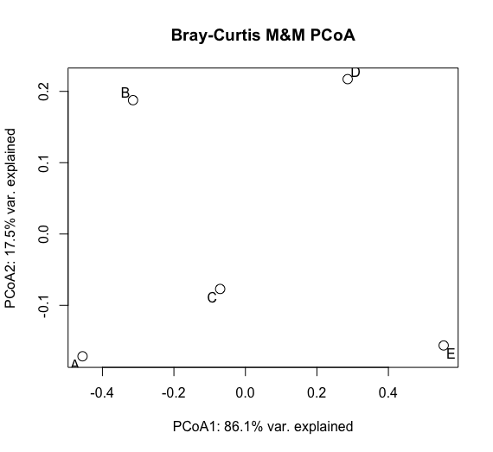
How did we do?
Bray Curtis ordination

Slide 49
